Slide 1
INDIAN CARGO SHIPMENT
A cargo ship is a merchant ship that carries cargo, goods, and materials from one port to another. Thousands of cargo carriers ply the world's seas and oceans each year, handling the bulk of international trade.

Slide 2
Units of cargo shipping:
Delivery Status
Delivery Master
Branch details
Cargo ship Details
Employee Details

Slide 3
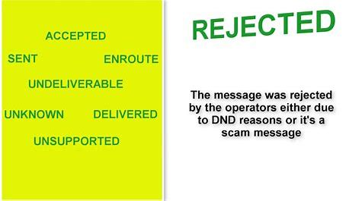
Delivery status:The delivery status reflects the actual delivery status of a line item. That status is then aggregated at the header level to summarize the status at the entire document level. The “actual delivery status” mentioned above reflects whether or not the item has been delivered:

Slide 4
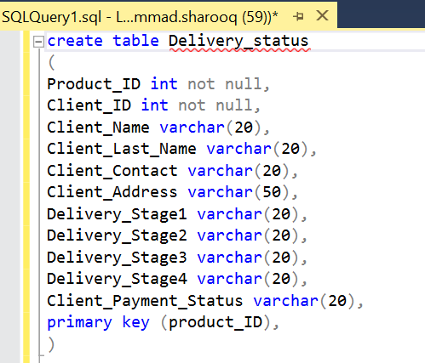
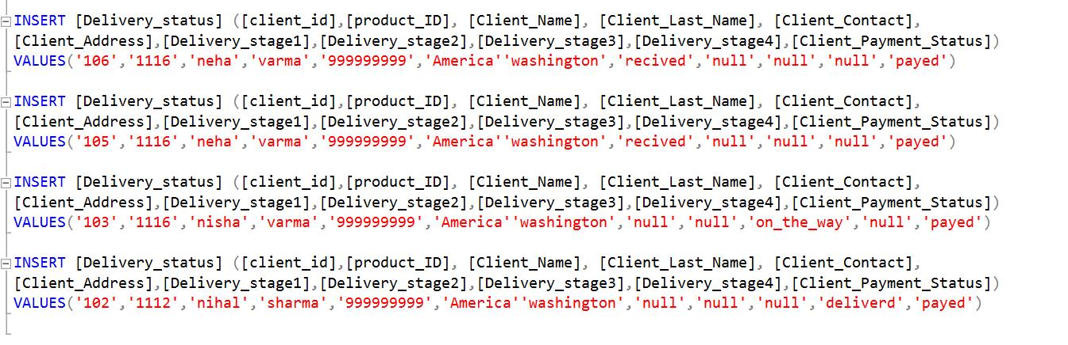
Table for Delivery status: (SNAP SHOTS)

Slide 5

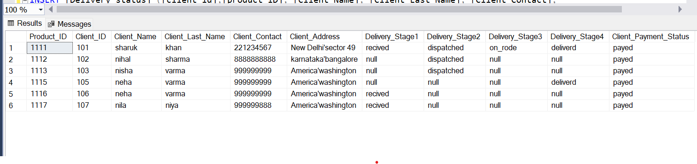
(Snapshots)

Slide 6
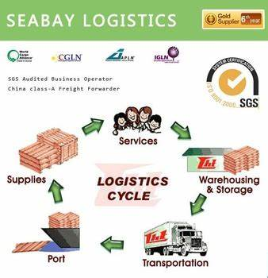
Delivery Master: The delivery-master helps you master the complete releases of your system consisting of different components to be deployed across different staging environments.

Slide 7
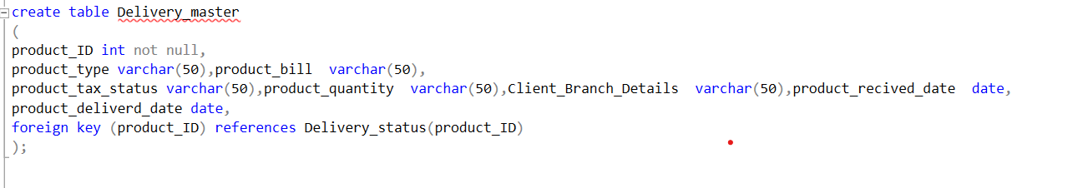
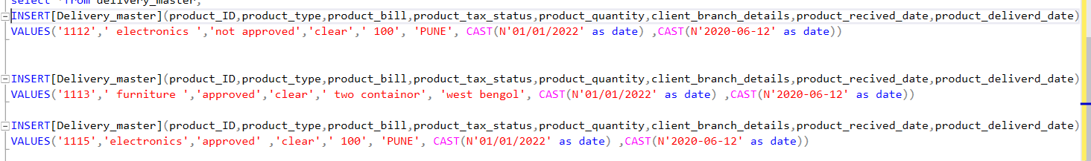
Table for Delivery master: (SNAPSHOTS)

Slide 8
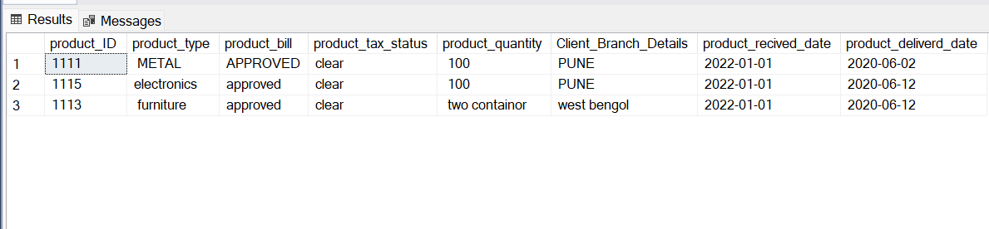

(SNAPSHOTS)

Slide 9


